Slide 1
Past, Present and Future of Mobile Technologies
Luke Scully

Slide 2
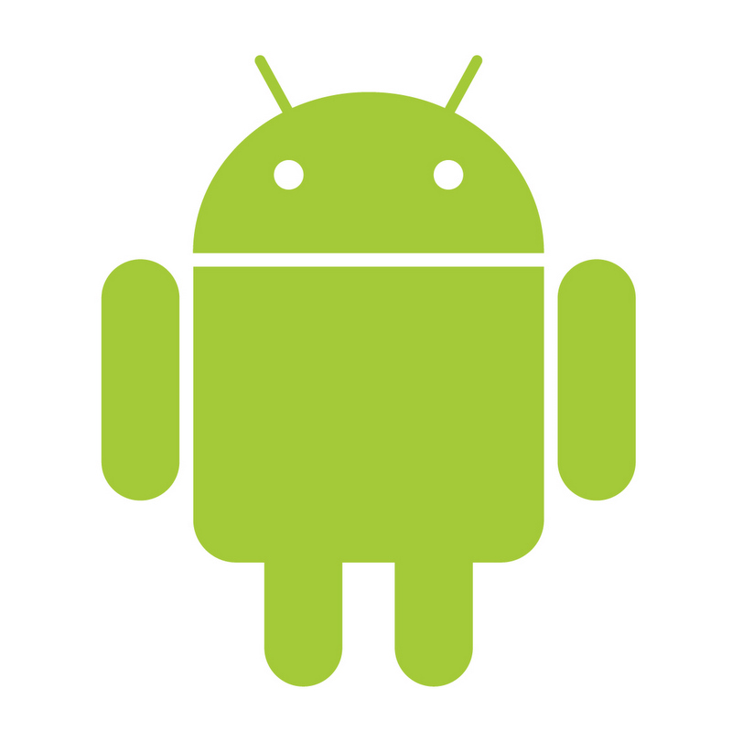
Past - Android
Android has had several larger updates as it first came out in with this first update/release being numbered 1.0 and codenamed cupcake
Version history:
1.0
1.5 Cupcake
1.6 Donut
2.0 Eclair
2.2 Froyo
2.3 Gingerbread
3.0 Honeycomb
4.0 Ice cream sandwich
4.1 Jellybean
4.4 KitKat
5.0 Lollipop
6.0 Marshmallow
Notes:
Since its initial release in 2008 android has had several large updates that always denote large feature changes and interesting innovations. With this first release being version 1.0 which brought with it an interesting user interface as well as some of the basic features singing in later versions of the OS, and its most recent update version 6.0 days brought with it interesting features such as natively supported fingerprint scanner and its new do not disturb mode.
Here's a short list of major android updates as well as I could mean simply states:
1.0 which was released on 23 September 2008 this was the first publicly released version of android only one phone support the OS.
Version 1.5 code-named cupcake which was released on 27 April 2009 this update brought with it interesting ideas such as widget support as well as animated transitions.
Version 1.6 code-named donut released on 15 September 2009 it brought with it speech synthesis been able to convert text into synthesised speech as well as expanded gesture network which will boost accessibility.
Version 2.0 code-named eclair released 26th of October 2009 it gave the OS expanded accounts synchronisation allowing multiple accounts to be synchronised to one phone as well as multitouch tracking.
Version 2.2 code-named Froyo released 20th of May 2010 bring with it USB tethering on Wi-Fi hotspot functionality as well as Bluetooth docking and Adobe Flash support.
Version 2.3 codenamed gingerbread released 6 December 2010 giving the OS support for near Field communication or NFC.
Version 3.0 code-named honeycomb released 22 February 2011 bring with it its new holographic interface as well as multicore support.
Version 4.0 code-named ice cream sandwich released 18 October 2011 it gave the operating system are interesting new feature which allowed the phone to be unlocked using a picture of the users face.
Version 4.1 code-named jellybean released ninth of July 2012.
4.4 code-named KitKat Release the 31st of October 2013 bring with it host card emulation allowing a card to be emulated using the and FC features as well as the release of android wear which also coincided release of devices such as android watches.
Version 5.0 code-named lollipop released 12 November 2014 this version of the OS include material design improving the quality of the user interface.
Version 6.0 the latest update code-named marshmallow released 5 October 2015 it brought with it features such as natively supporting fingerprint scanners as well as a new do not disturb mode.

Slide 3

Past - IOS
Visuals
Different versions and their changes
Versions IOS1.0 through IOS8.0
Notes:
Over the different generations of IOS the visuals have changed considerable from being clunky in design to its more slim line and sleek look that it has now.
With iOS first update from its base operating system many features were updated including its core UI, such as the addition of multi-touch gestures, "mobile Safari", maps. With its second update came better location tracking, the ability to rearrange icons and multi-touch keyboard. After that came iTunes Wi-Fi music store and iPod touch compatibility. With the introduction of iOS 2.0 the early West started to support native third-party apps the introduction of an app store and Microsoft exchange support. With its first and second update to version 2.0, version 2.1 and 2.2 iOS improved its battery life included iTunes Genius playlists as well as general bug fixes version 2.2 introduced Google Street view and podcast downloads. With iOS version 3.0 came copy paste features voice control MMS and push notifications as well as USB and Bluetooth tethering. With the introduction of iOS 3.2 alongside it came the iPad this update mainly improve support for the iPad, iOS-based tablet. With the introduction of 4.0 came multitasking, home screen folders, FaceTime video chatting and unified email boxes. IOS version 5 brought features such as Siri the built in "personal helper", the ability to synchronise devices via Wi-Fi as well as I messenger and I cloud. Version 6.0 of iOS brought with it its own maps app enhancements to the "Siri", passbook feature allowing you to store things such as tickets, male enhancements and FaceTime over cellular networks. Versions seven and eight brought with them aesthetic changes as well as several basic apps.

Slide 4
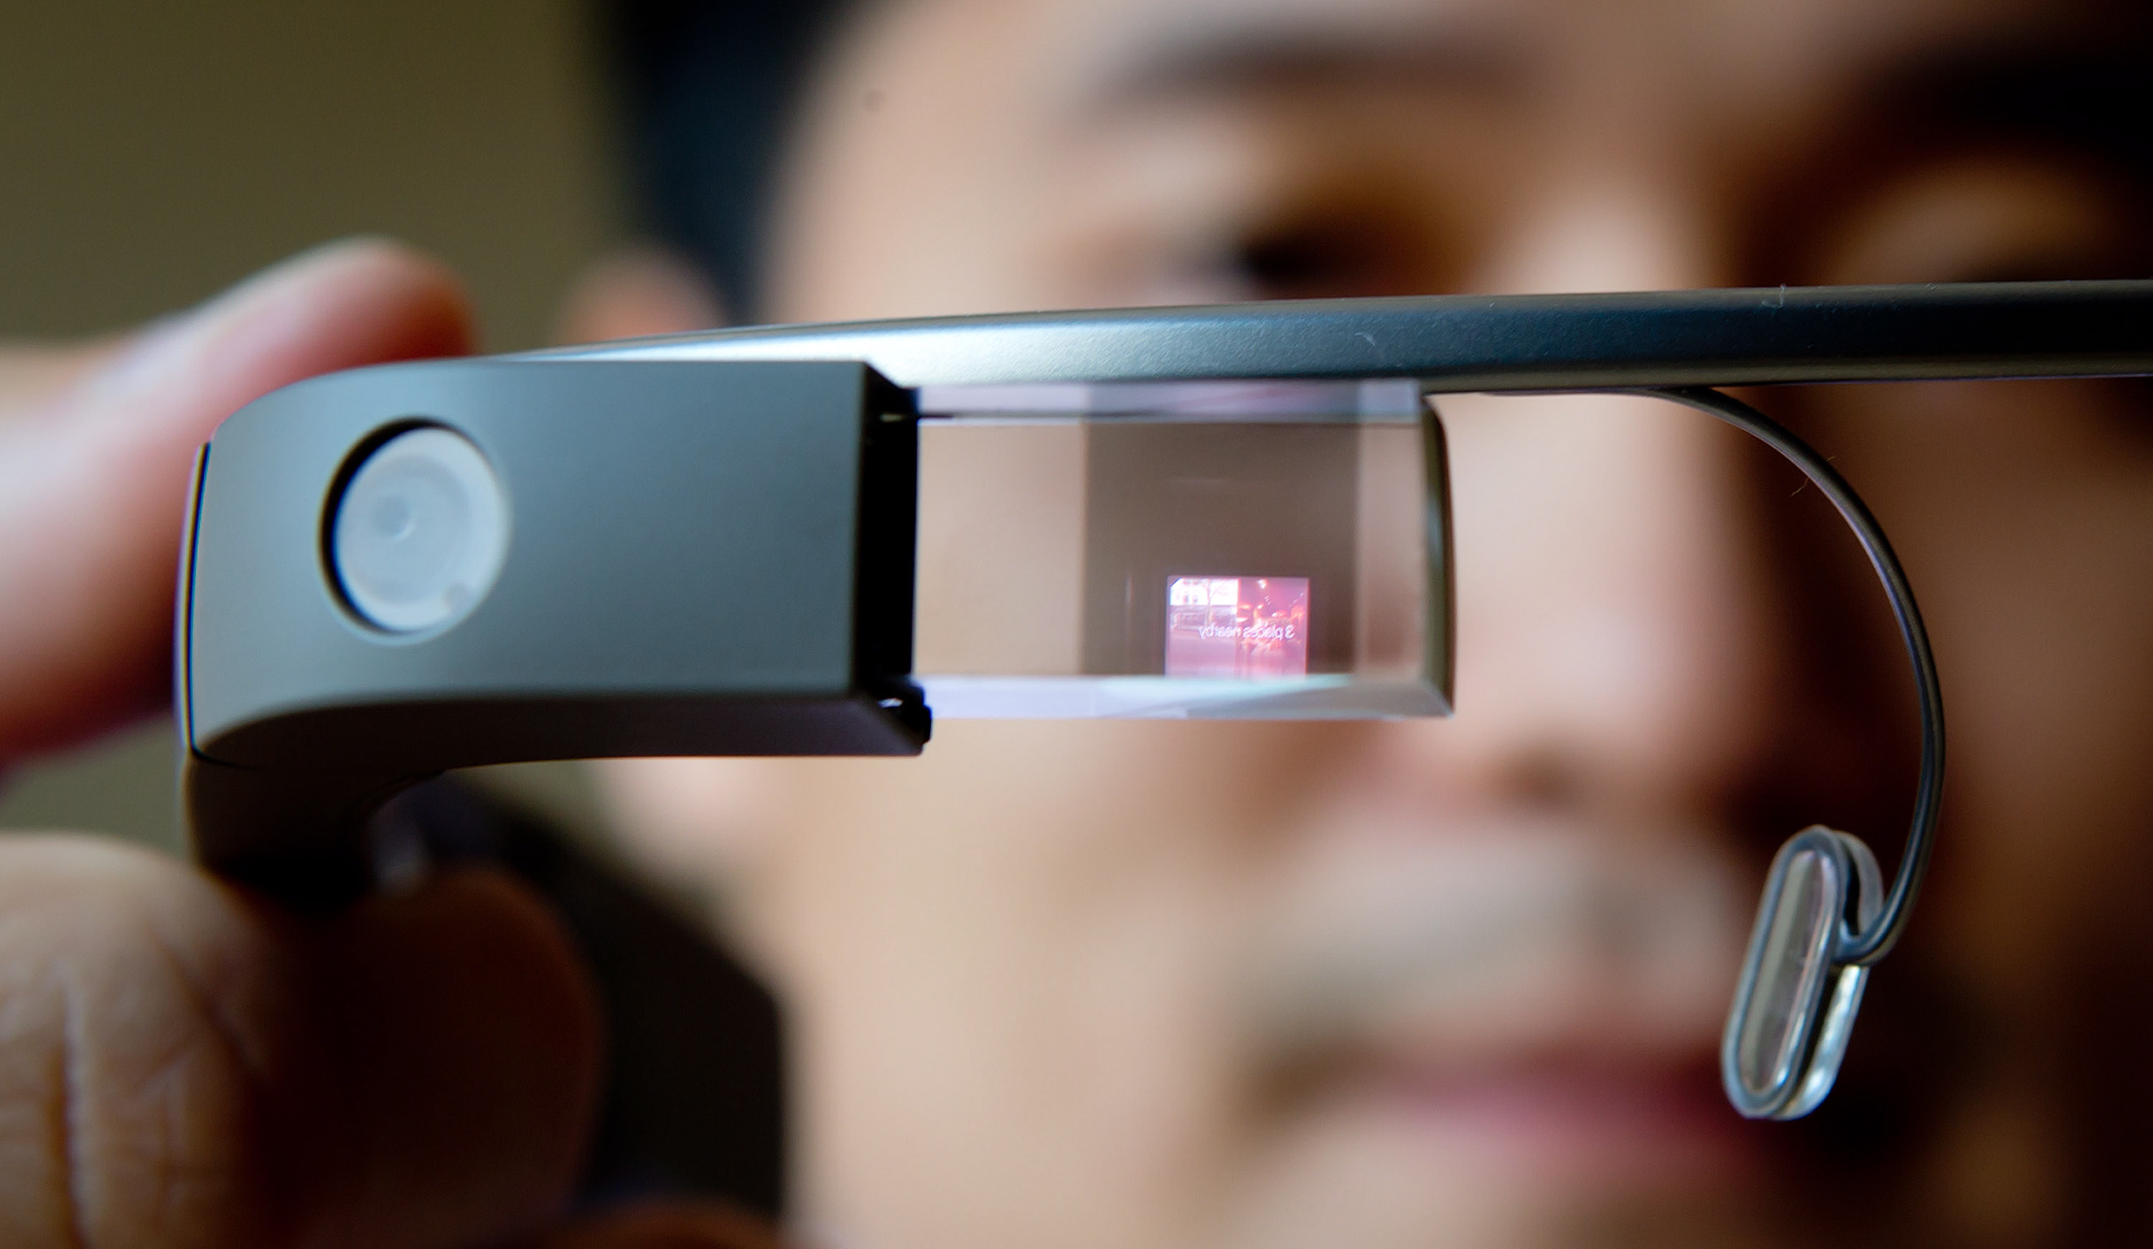
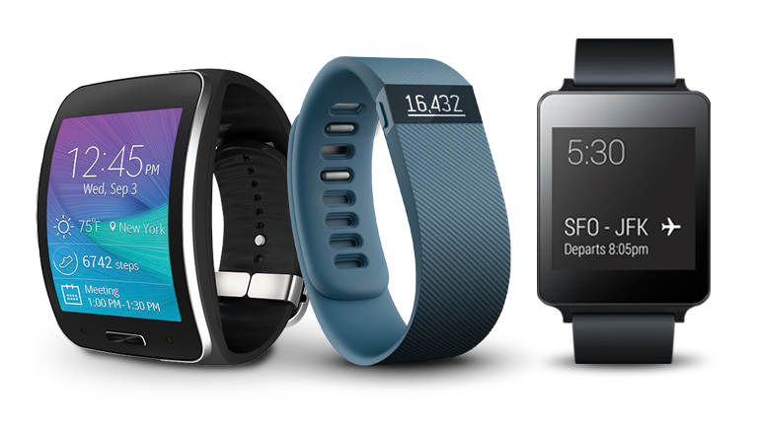
Present - Wearables
Google glass
Smart watches
Google cardboard
Notes:
The latest design in mobile technology being wearable tech lots of different designs and styles have shown up on the market. Designs such as Google glass are a wearable based on an interface built into a pair of glasses, and other new interesting wearable design such as Smart watches which more obviously are designed to be one of the wrist. The company Google has also come out with another interesting wearable design which is Google cardboard being a accessory attached to the phone turning the phone into a set of virtual reality glasses.

Slide 5
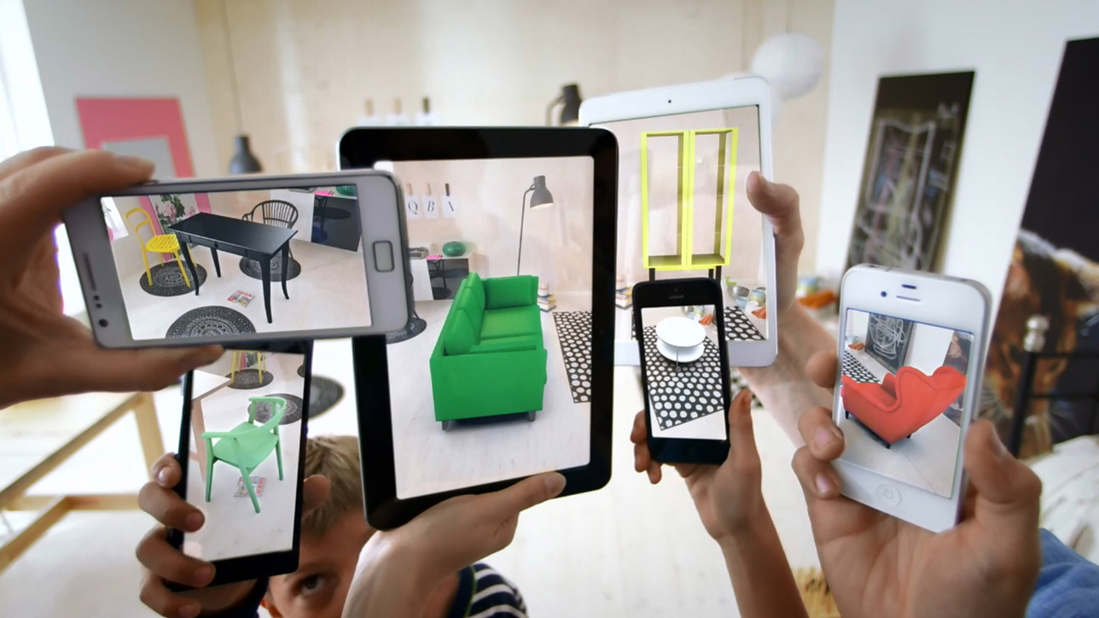
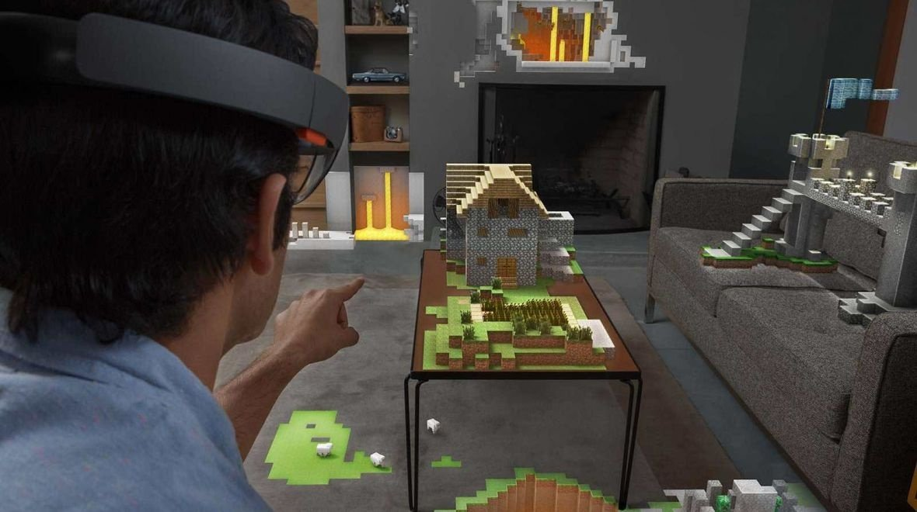
THE FUTURE 5 years - Virtual reality and Augmented reality
Oculus Rift
HoloLens
Notes:
Though still a pipe dream for many virtual reality and augmented reality technology is quickly becoming more and more of a reality. Several companies have already begun making virtual reality and augmented reality devices, devices such as oculus rift and Microsoft's HoloLens. With Microsoft unveiling their new product the HoloLens augmented reality is a step close to be in reality. Whereas the oculus rift virtual reality device is already in production with developer kits being sold already which just goes to show how close in the future it is.

Slide 6
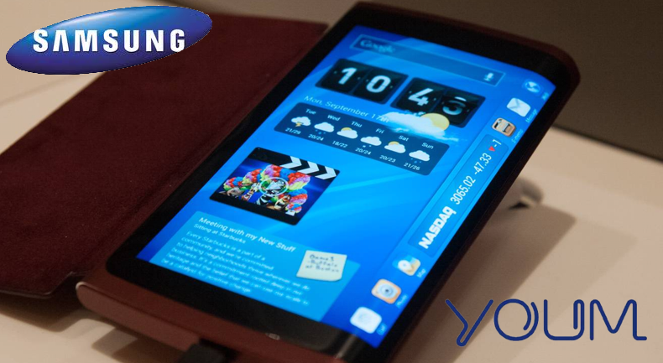
THE FUTURE 10 years - Flexible Screens
Roll able monitors
Curved edges
Notes:
Though maybe not as interesting as augmented or virtual reality from the point of view of a mobile user they are a little more interesting. If the current and signs for flexible screens go into production that could open up a whole new market for smaller more compact phones and mobile devices, imagine having a small object the size of a lipstick tube in your pocket and when you get a call all you have to do is pull that out of your pocket unravel it and you have yourself a neat compact phone. This technology however is not only promising for your typical mobile user for example imagine being able to carry around a role of flexible screen alongside your laptop and having instant access to multiple monitors, without having to lug around a couple kilo secondary monitor. This technology is also interesting is not only does it allow for this more portable ideas, but also gives developers the ability to make more flexible designs such as one of the new phones which recently came out using this technology giving the phone the ability to have a curved screen that wraps around the edge of the phone.

